Slide 1
Module 11: Well-Architected Pillar 3-Reliability
Notes:
Welcome to Module 11, where you learn about the third pillar of the Well-Architected Framework: Reliability.
While this module discusses many best practices, it also talks about how to use the Amazon Web Services—or AWS—environment to implement scenarios that improve the reliability of a system. The following tools and services focus on reliability, and are discussed throughout this module:
• AWS Identity and Access Management, or IAM
• Amazon Virtual Private Cloud, or Amazon VPC
• AWS Trusted Advisor
• AWS Shield
• AWS CloudTrail
• AWS Config
• Amazon CloudWatch
• Auto Scaling
• AWS CloudFormation
• Amazon Simple Storage Service, or Amazon S3
• Amazon Glacier
• AWS Key Management Service, or AWS KMS

Slide 2
What’s In This Module
Part 1: Principles Of The Reliability Pillar
Part 2: Making Your Infrastructure More Reliable
Exercise: Improve This Architecture
Part 3: Exercise: Improve This Architecture
Part 4: Reliability Pillar Questions
Lab: Multi-Region Failover With Amazon Route 53
Notes:
In part 1, you will learn about the principles of the Reliability pillar.
In part 2, you will learn how to make your infrastructure more reliable.
In part 3, you will complete an exercise to improve an example architecture.
In part 4, you will consider various questions regarding reliability, and learn some best practices. You’ll have an opportunity to improve an architecture.
Finally, you’ll complete this module with a Lab: Multi-Region Failover with Amazon Route 53.

Slide 3
Module Objectives
Upon completion of this module, you will be able to:
Describe the ability of a system to recover from infrastructure or service disruptions, dynamically acquire computing resources to meet demand, and mitigate disruptions such as misconfigurations or transient network issues.
Identify the design principles and the best practices of the Reliability pillar.
Notes:
Upon completion of this module, you will be able to:
• Describe the ability of a system to recover from infrastructure or service disruptions, dynamically acquire computing resources to meet demand, and mitigate disruptions such as misconfigurations or transient network issues.
• Identify the design principles and the best practices of the Reliability pillar.
This module also reviews four example architectural patterns for implementing a reliable solution.

Slide 4
Part 1: Principles of the Reliability Pillar
Notes:
Let’s begin by learning about the principles of the Reliability pillar.

Slide 5
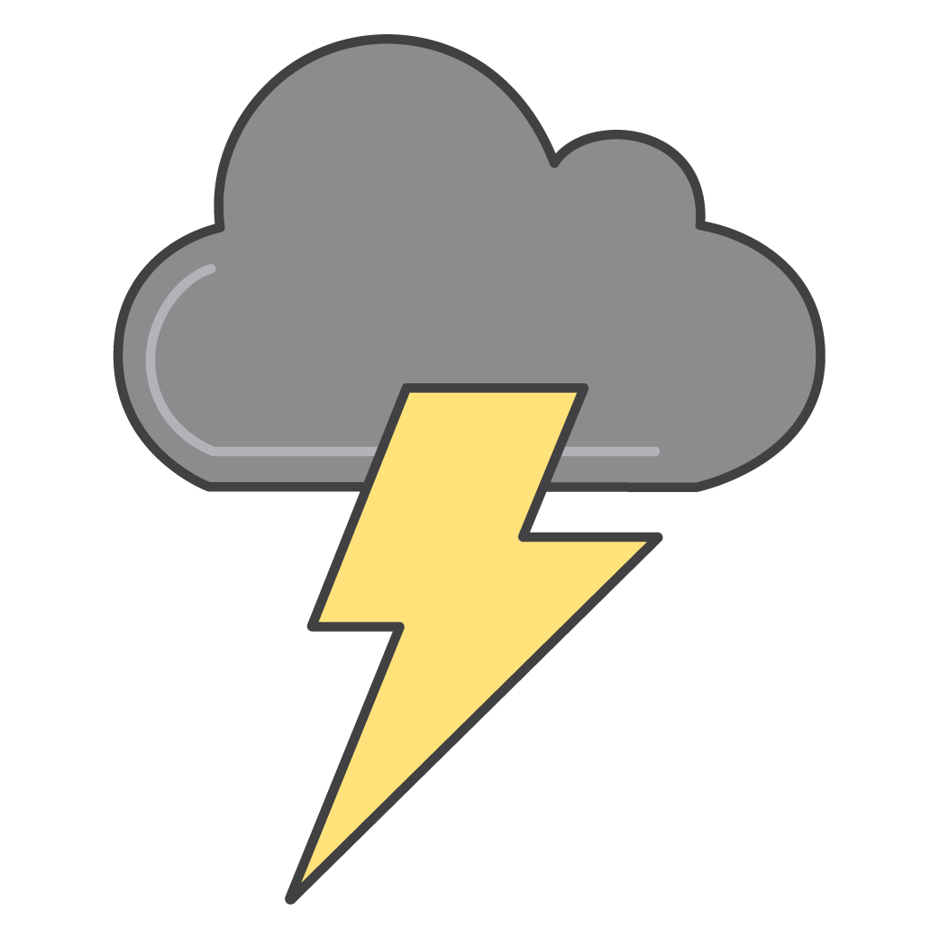
Well-Architected Pillar 3: Reliability
The ability of a system to recover from infrastructure or service failures, dynamically acquire computing resources to meet demand, and mitigate disruptions such as misconfigurations or transient network issues.
Foundations
Change management
Failure management
Notes:
Reliability is the ability of a system to recover from infrastructure or service failures, dynamically acquire computing resources to meet demand, and mitigate disruptions such as misconfigurations or transient network issues.
The goal of reliability is to keep the impact of any type of failure to the smallest area possible. By preparing your system for the worst, you can implement a variety of mitigation strategies for the different components of your infrastructure and applications.
Reliability focuses on the ability to recover from failures and meet demand in three areas:
• Foundational elements that include setup and cross-project requirements
• How you manage change
• And recovering from failure by using failure management

Slide 6
Reliability: Design Principles
Test recovery procedures.
Automatically recover from failure.
Scale horizontally to increase aggregate system availability.
Stop guessing capacity.
Manage change in automation.
Notes:
Let’s review each design principle for reliability.
• Make sure to test your recovery procedures. Plans on paper might not execute as smoothly after it’s live and under stress. It’s better to test your deployment in a test situation or in a game day situation instead of through an actual event.
• Automatically recover from failure. If you have your systems set up with automatic scaling, you can automatically scale out to absorb issues that you might experience during a component failure.
• Scale horizontally to increase aggregate system availability, and meet demand.
• Stop guessing what you actually need for capacity.
• And manage all changes in automation that were already tested in a development or QA environment before being deployed to a production environment.

Slide 7




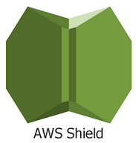




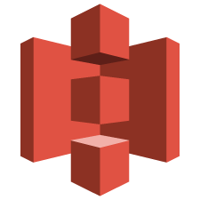


Key Services for Reliability
Areas | Key Services
Foundations
Change management
Failure management
Amazon
CloudWatch
AWS
Trusted Advisor
AWS IAM
Amazon VPC
AWS Shield
AWS CloudTrail
AWS Config
Amazon CloudWatch
Auto Scaling
AWS CloudFormation
Amazon S3
Amazon Glacier
AWS KMS
Notes:
This slide shows the AWS services that focus on reliability.
The AWS service that is key to ensuring reliability is Amazon CloudWatch, which gives you a holistic view of the performance of your workload. Other services and features that support the three areas of reliability include foundations, change management, and failure management.
• For foundations, AWS Identity and Access Management –or IAM—enables you to securely control access to AWS services and resources. Amazon VPC lets you provision a private, isolated section of the AWS Cloud where you can launch AWS resources in a virtual network. AWS Trusted Advisor provides visibility into the limits of the AWS services that you use. AWS Shield is a managed service that protects against distributed denial of service—or DDOS—attacks, and safeguards web applications that run on AWS.
• For change management, AWS CloudTrail records AWS API calls for your account, and delivers log files to you for auditing. AWS Config provides a detailed inventory of your AWS resources and configuration, and it continuously records configuration changes. Amazon CloudWatch provides the ability to send alerts about metrics, including custom metrics. Auto Scaling is a service that provides automated demand management for a deployed workload.
• For failure management, AWS CloudFormation provides templates for the creation of AWS resources and provisions them in an orderly and predictable fashion. Amazon Simple Storage Service—or Amazon S3— provides a highly durable service to keep backups, and Amazon Glacier provides highly durable archives. AWS Key Management Service—or AWS KMS—provides a reliable key management system that integrates with many AWS services.

Slide 8
Part 2: Making Your Infrastructure More Reliable
Notes:
Next, you will learn how to make your infrastructure more reliable.

Slide 9
Disaster Recovery on AWS
Example architectural patterns (sorted from highest to lowest RTO/RPO):
Backup and Restore
Pilot Light
Fully Working Low-Capacity Standby
Multi-Site Active-Active
Notes:
Let’s cover some common practices for disaster recovery—or DR—inside of AWS.
The example architectural patterns involve recovery time objectives, or RTOs, and recovery point objectives, or RPOs. They are sorted from the highest RTO and RPO to the lowest RTO and RPO.
As a reminder, the recovery time objective is the time that your business is down during an outage. The recovery point objective is the amount of data that will be lost.
• The first example is when you want to perform a simple backup and restore operation.
• The second example is the “pilot light” architecture.
• The third example is a fully working low-capacity standby architecture.
• And the last example is a multi-site active-active architecture.

Slide 10



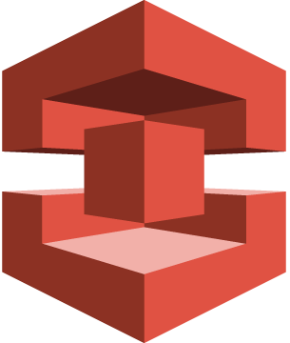
Backup and Restore
Amazon Route 53
Data copied
to Amazon S3
Traditional server
Amazon S3 Bucket
with Objects
AWS Snowball
On-premises Infrastructure
Notes:
This diagram shows a basic disaster recovery system. In this diagram, the data is in a traditional data center. Amazon Route 53 points to the data center, and it copies data either by using AWS Snowball or directly into an Amazon S3 bucket that stores the data.

Slide 11



Backup and Restore
Data copied from objects in bucket
Instance quickly provisioned from AMI
Data Volume
Amazon EC2
Instance
Amazon S3 Bucket
Pre-bundled with OS and applications
AMI
Availability Zone
AWS Region
Notes:
Here is an example of how you would restore the system using the backup and restore method. In this scenario, you should already have an Amazon Machine Image, or AMI, that you can use to provision an instance. After you provision an instance, you can then copy the data over from your Amazon S3 bucket. Then, you switch Amazon Route 53 to point to your site in AWS.

Slide 12
Backup and Restore
Advantages
Simple to get started.
Extremely cost effective (mostly backup storage).
Preparation Phase
Take backups of current systems.
Store backups in Amazon S3.
Describe procedures to restore from backup on AWS.
Know which AMI to use; build your own as needed.
Know how to restore system from backups.
Know how to switch to new system.
Know how to configure the deployment.
Notes:
The advantages of the backup and restore option are that it’s simple to get started, and it’s extremely cost-effective. In this scenario, you will mostly pay for backup storage.
For the preparation phase:
Take backups of current systems.
Store backups in Amazon S3.
Describe procedures to restore from backups on AWS.
• Know which AMI to use, and build your own AMI as needed.
• Know how to restore the system from backups.
• Know how to switch to a new system.
• And know how to configure the deployment.

Slide 13
Backup and Restore
In case of disaster
Retrieve backups from Amazon S3.
Boot up required infrastructure.
Amazon EC2 instances with prepared AMIs, Elastic Load Balancing, etc.
Use AWS CloudFormation to automate deployment of core networking.
Restore system from backup.
Switch over to the new system.
Adjust DNS records to point to AWS.
Objectives
RTO: as long as it takes to bring up infrastructure and restore system from backups.
RPO: time since last backup.
Notes:
In case of a disaster, you can:
• Retrieve backups from Amazon S3.
• Boot up the required infrastructure, including Amazon Elastic Compute Cloud—or Amazon EC2—instances with prepared AMIs, Elastic Load Balancing, and so on. Use AWS CloudFormation to automate the deployment of core networking.
• Restore your system from a backup.
• And then switch over to the new system, adjusting Domain Name System—or DNS—records to point to AWS.
For the backup and restore option, the recovery time objective—or RTO—is as long as it takes to launch the infrastructure and restore your system from backups.
The recovery point objective—or RPO—is the time since your last backup.

Slide 14



Pilot Light
User or system
Web
Server
Web
Server
Not running
App
Server
Amazon Route 53
Hosted Zone
App
Server
Database
Server
Database
Server
Smaller instance
Data Mirroring/Replication
Data Volume
Data Volume
Notes:
For this example of a “pilot light” architecture, you have an on-premises system, and Amazon Route 53 points to your on-premises system. You have a smaller database instance in the AWS Cloud where you mirror data or replicate data from your on-premises system. You have two servers that represent your web tier and your application tier, but they are not on and running yet.

Slide 15
Pilot Light
User or system
Web
Server
Web
Server
Start in minutes
App
Server
Amazon Route 53
Hosted Zone
App
Server
Database
Server
Database
Server
Resize to PROD capacity
Data Mirroring/Replication
Data Volume
Data Volume
Notes:
If the primary system fails, you grow your database server to the size that it needs to be to take on production data traffic. Next, you turn on your web server and application server. You then point Amazon Route 53 to your new servers. This entire process can happen in minutes.

Slide 16
Pilot Light
Advantage
Very cost-effective (Uses fewer 24/7 resources).
Preparation Phase
Take backups of current systems
Store backups in S3
Describe procedure to restore from backup on AWS
Know which AMI to use; build your own as needed
Know how to restore system from backups
Know how to switch to new system
Know how to configure the deployment
Notes:
An advantage of the pilot light architecture is that it’s very cost-effective. It uses fewer resources than an active-active situation.
For the preparation phase, consider the time that it takes to handle backups of your current systems. Store backups in Amazon S3, and describe the procedure you use to restore your system from backups on AWS.
Know which AMI to use, and build your own as needed.
Know how to restore your system from backups.
Know how to switch to a new system.
And know how to configure the deployment.

Slide 17
Pilot Light
In case of disaster
Automatically bring up resources around the replicated core data set.
Scale the system as needed to handle current production traffic.
Switch over to the new system.
Adjust DNS records to point to AWS.
Objectives
RTO: as long as it takes to detect need for DR and automatically scale up replacement system.
RPO: depends on replication type.
Notes:
In case of a disaster, you can:
Automatically bring up your resources around the replicated core data set.
Scale the system as needed to handle current production traffic.
Finally, switch over to the new system, and adjust the DNS records to point to AWS.
The RTO is as long as it takes for you to detect that you need disaster recovery, and to automatically scale up a replacement system.
The RPO will depend on how you replicate your data between your on-premises system and the AWS Cloud.

Slide 18
Fully Working Low-Capacity Standby
User or system
Web
Server
Web
Server
Amazon Route 53
Hosted Zone
App
Server
App
Server
Low capacity
Database
Server
Database
Server
Data Mirroring/Replication
Data Volume
Data Volume
Notes:
Now, let’s discuss a fully working low-capacity standby architecture. A low-capacity standby architecture is like the next level of the pilot light architecture.
In this scenario, you have two running systems: the main system and a low-capacity system that runs on AWS. You can use Amazon Route 53 to distribute requests between the main system and the cloud system.

Slide 19
Fully Working Low-Capacity Standby
User or system
Web
Server
Web
Server
Amazon Route 53
Hosted Zone
App
Server
App
Server
Grow capacity
Database
Server
Database
Server
Data Mirroring/Replication
Data Volume
Data Volume
Notes:
If an actual catastrophic event takes over your on-premises infrastructure, you only need to change your DNS records to point to your AWS Cloud site.
Then, you can grow capacity by using horizontal scaling or vertical scaling of your instances. In this case, Amazon Route 53 switches over to the secondary system, which is designed to automatically scale up its capacity if there is a failover from the primary system.

Slide 20
Fully Working Low-Capacity Standby
Advantages
Can take some production traffic at any time
Cost savings (IT footprint smaller than full disaster recovery)
Preparation
Similar to Pilot Light.
All necessary components running 24/7, but not scaled for production traffic.
Best practice: continuous testing.
“Trickle” a statistical subset of production traffic to DR site.
Notes:
Some of the advantages of a fully working low-capacity standby architecture include that it can take some production traffic at any time, and there is a cost savings because the IT footprint is smaller than that of a full disaster recovery.
The preparation is similar to the pilot light scenario.
All necessary components and instances are running 24/7, but it’s not scaled for production traffic.
A best practice for the fully working low-capacity standby is continuous testing.
You can use the “trickle” test method, and have a statistical subset of your production traffic go to your disaster recovery site. This method can alert you to any issues in your infrastructure before you need to rely on your disaster recovery site to handle all of your production traffic.

Slide 21
Fully Working Low-Capacity Standby
In case of disaster
Immediately fail over most critical production load.
Adjust DNS records to point to AWS.
(Auto) Scale the system further to handle all production load.
Objectives
RTO: for critical load: as long as it takes to fail over; for all other load, as long as it takes to scale further.
RPO: depends on replication type.
Notes:
In case of a disaster, you can:
Immediately fail over the most critical production load.
Adjust your DNS records to point to AWS.
And Auto Scale the system further to handle all production load traffic.
Your RTO can take the critical load immediately for as long as it takes to fail over. For all other loads, it will be as long as it takes to scale further.
The RPO depends on your replication type.
To clarify, does this mean use the Amazon EC2 Auto Scaling feature, or to automatically scale?
Does this sentence express the idea that the RTO is the time it takes for the critical load to fail over?
The use of “it” here is ambiguous. Does it refer to RTO?

Slide 22
Multi-Site Active-Active
User or system
Web
Server
Web
Server
Amazon Route 53
Hosted Zone
App
Server
App
Server
Full capacity
Database
Server
Database
Server
Data Mirroring/Replication
Data Volume
Data Volume
Notes:
For a multi-site active-active architecture, you have a full-size, production-capable infrastructure within the AWS Cloud. In this case, all of the servers are already operating at full capacity and can take the load at any time. You also perform data mirroring and replication between two sites.

Slide 23
Multi-Site Active-Active
Advantage
Can take all production load at any moment.
Preparation
Similar to Low-Capacity Standby.
Fully scaling in/out with production load.
In Case of Disaster
Immediately fail over all production load.
Objectives
RTO: as long as it takes to fail over.
RPO: depends on replication type.
Notes:
The advantage of a multi-site active-active architecture is that it can take on all of the production load at any time.
The preparation for this architecture is similar to that of a low-capacity standby, except you that don’t need to scale in or out with the production load because the environment is already at full capacity.
In the case of a disaster, you can immediately fail over your entire production load. To fail over, point your DNS record to ensure that all traffic is sent to your disaster recovery site within the AWS Cloud.
The RTO is as long as it takes to fail over, and the RPO depends on your replication type.

Slide 24
Best Practices for Being Prepared
Start simple and work your way up
Backups in AWS as a first step.
Incrementally improve RTO or RPO as a continuous effort.
Check for any software licensing issues.
Exercise your DR Solution
Practice "Game Day" exercises.
Ensure backups, snapshots, AMIs, etc. are working.
Monitor your infrastructure.
Notes:
One of the best practices for being prepared is to start simple and work your way up.
As a first step, make sure your backups in AWS work.
Also, incrementally improve the RTO and the RPO as a continuous effort.
Another best practice is to always check for any software licensing issues.
Finally, you should exercise your disaster recovery solution.
• Practice "game day" exercises.
• Ensure that your backups, snapshots, AMIs, and other recovery resources work, and make sure that everyone knows your disaster recovery plan thoroughly.
• Make sure that you monitor your infrastructure so that if anything happens to your production environment, you can quickly implement your disaster recovery plan.

Slide 25
Advantages of Disaster Recovery with AWS
Various building blocks available.
Fine control over cost vs. RTO or RPO tradeoffs.
Ability to easily and effectively test your DR plan.
Availability of multiple locations worldwide.
Managed desktops available.
Amazon WorkSpaces provides a fully managed desktop computing service in the cloud.
Variety of solution providers.
Notes:
Some of the advantages of disaster recovery with AWS include:
• Various building blocks are available.
• You have control over costs because it doesn’t require a second environment. You can spin it up quickly, test it, and then spin it back down to save costs.
• You can quickly and effectively test your disaster recovery plan.
• Multiple locations are available worldwide.
• Managed desktops are available.
• Amazon WorkSpaces provides a fully managed desktop computing service in the cloud with a variety of solution providers.

Slide 26



Managed Desktops in the Cloud
Amazon WorkSpaces is a fully managed desktop computing service in the cloud.
Key benefits:
Fully managed
Supports multiple devices
Keeps data secure and available
You can choose software and hardware
Monthly and hourly billing options
Corporate directory integration
Supports tagging
Notes:
Amazon WorkSpaces is a fully managed desktop computing service in the cloud. We do all of the heavy lifting and provisioning of hardware and software for customers. All customers need to do is launch the number of WorkSpaces that they need. The service takes care of all underlying provisioning processes. When the WorkSpaces are ready, users will receive an email that provides them with instructions on how to obtain a client and connect to their WorkSpaces.
Amazon WorkSpaces provides customers with a choice of devices that they can use to connect to their desktop. They can use an iPad, a Kindle Fire, a Windows desktop, or a Mac desktop. Both iPad and Android clients have numerous optimization options available that can make a desktop experience on the device intuitive, such as a slide-out radial control to access commonly used functions, and a choice of mouse modes.
This service can help keep data secure and available, and you can select your chosen software and hardware.
Billing includes monthly and hourly options so that you can purchase only what you need.
Amazon WorkSpaces integrates with customers’ corporate directories. This means that all WorkSpaces that are provisioned by a customer will join the customer’s Active Directory domain. Users can continue to use their existing corporate credentials to get seamless access to their corporate resources, such as Exchange, SharePoint, and other internal applications. For administrators, the fact that these WorkSpaces join the customer’s Active Directory domain means that they can be managed just like any other desktops, along with any management tools or processes that customers already use.
You can use tags to manage and track your Amazon WorkSpaces. You can use tags to categorize your Amazon WorkSpaces so that you can easily identify their purpose, and track costs accordingly.

Slide 27
Exercise: Improve This Architecture
Notes:
Next, you will complete an exercise where you will improve an example architecture.

Slide 28
Exercise: Reliability
Your team has just finished forklifting an application into the cloud. Due to a previous failure of the system, your CTO requests a Well-Architected review of the system.
Review the sample diagram and ask questions to identify where improvements can be made to increase the reliability of the system.
Recommend reliability enhancements in accordance with the Well-Architected Reliability pillar.
Notes:
In this scenario:
• Your team has just finished forklifting an application into the cloud. Due to a previous failure of the system, your CTO requests a Well-Architected review of the system.
• Review the sample diagram and ask questions to identify where you can make improvements to increase the reliability of the system.
• Recommend reliability enhancements in accordance with the Reliability pillar of the Well-Architected Framework.

Slide 29






Exercise: Reliability
RDS Master
App Server
Web Server
Bastion Host
Public Subnet
Availability Zone 1
IGW
RDS Standby
App Server
Web Server
Bastion Host
Public Subnet
Availability Zone 2
Notes:
In the scenario shown, what reliability enhancements would you make in accordance with the Reliability pillar of the Well-Architected Framework?

Slide 30



Exercise: Reliability
RDS Master
Amazon ElastiCache
App Server
Web Server
Bastion Host
Provate Subnet
Availability Zone 1
ASG 1:1:1
IGW
RDS Standby
Amazon ElastiCache
App Server
Web Server
Private Subnet
Public Subnet
Availability Zone 2
Notes:
Take a moment to discuss the following:
• Loose coupling: Add internal Elastic Load Balancing load balancers or Amazon SQS between the web and application servers.
• Use session information to offload data to Amazon DynamoDB or Amazon ElastiCache.
• Consider whether using Read Replicas would increase reliability.
• Use Auto Scaling groups to ensure the available workload.
• 1:1:1 ASG on the bastion host

Slide 31

Lab: Multi-Region Failover with Amazon Route 53
~ 30 minutes
Notes:
Now, you will work on a lab that focuses on a multi-Region failover with Amazon Route 53.
This lab will take approximately 30 minutes.

Slide 32



Lab: Scenario
In this lab, you will configure and test a cross-region disaster recovery scenario.
It comes with a basic application environment already created and made available across two separate regions.
Here are the services this lab will use:
Amazon Route 53
Amazon EC2
Amazon VPC
Notes:
In this lab, you will configure and test a cross-Region disaster recovery scenario.
The lab provides an already-created basic application environment, which is made available across two separate Regions.
The services you will use include:
• Amazon Route 53
• Amazon EC2
• And Amazon VPC

Slide 33



Lab: Tasks
Inspect resources in two regions.
Create an Amazon Route 53 health check.
Create an Amazon Route 53 domain.
Configure primary and secondary settings.
Test failover.
⑃
☑️
Notes:
The list of tasks you will complete in this lab include:
• Inspecting resources in two Regions.
• Creating an Amazon Route 53 health check.
• Creating an Amazon Route 53 domain.
• Configuring primary and secondary settings.
• And testing the failover.

Slide 34
Lab: Final Product
Amazon Route 53
Health check
Failover
Web
App
Web
App
Region 1
Region 2
Primary
Secondary
~ 30 minutes
Notes:
Displayed is an example of the final product from the lab.

Slide 35
Additional Resources
Video and Analyst Report
Embracing Failure: Fault-Injection and Service Reliability
Benchmarking Availability and Reliability in the Cloud
Documentation and Blogs
Service Limits Documentation
Service Limit Reports Blog Post
Whitepapers
Backup, Architect and Restore Approach Using AWS Whitepaper
Managing Your AW Infrastructure at Scale Whitepaper
AWS Disaster Recovery Whitepaper
AWS Amazon VPC Connectivity Options Whitepaper
AWS Support
AWS Premium Support
Trusted Advisor
Notes:
Here are some additional resources for you to review.
Select each link to learn more.

Slide 36
Part 3: Reliability Pillar Questions
Notes:
In this next section, we will ask a question for you to consider, and provide some best practices.

Slide 37


Reliability Question #1
How are you managing AWS service limits for your account?
Best practices
Monitor and manage limits by evaluating your potential usage on AWS, increase your regional limits appropriately, and allow planned growth in usage.
Set up automated monitoring by implementing tools such as SDKs to alert you when thresholds are being approached.
Be aware of fixed service limits that are unchangeable and architect around those.
Notes:
How are you managing AWS service limits for your account?
Take a moment to review some best practices.

Slide 38
Reliability Question #2
How are you planning your network topology on AWS?
Best practices
Use highly available connectivity to AWS with:
Multiple AWS Direct Connect circuits
Multiple VPN tunnels
AWS Marketplace appliances
Size your IP subnet allocation to be large enough to accommodate future expansion.
Use highly available connectivity to the system with:
Highly available load balancing and/or proxy
DNS-based solutions
AWS Marketplace appliances
Use non-overlapping private IP ranges between all of your environments in and out of the cloud.
Notes:
How are you planning your network topology on AWS?
Take a moment to review some best practices.

Slide 39
Reliability Question #3
Do you have an escalation path to deal with technical issues?
Best practices
Plan ahead with an ongoing engagement or relationship with AWS Support or an APN Partner.
Use AWS Support APIs by integrating them with your internal monitoring and ticketing systems
Notes:
Do you have an escalation path to deal with technical issues?
Take a moment to review some best practices.

Slide 40
Reliability Question #4
How does your system adapt to changes in demand?
Best practices
Use automated scaling features from services such as:
Amazon S3
Amazon CloudFront
Auto Scaling
Amazon DynamoDB
AWS Elastic Beanstalk
Adopt a load testing methodology to measure if scaling activity will meet your application requirements.
Notes:
How does your system adapt to changes in demand?
Take a moment to review some best practices.

Slide 41
Reliability Question #5
How are you monitoring AWS resources?
Best practices
Monitor your applications with:
Amazon CloudWatch
Third-party tools
Configure notifications for when significant events occur.
Use automation to take action when failure is detected.
Perform frequent reviews of the system based on significant events to evaluate the architecture.
Notes:
How are you monitoring AWS resources?
Take a moment to review some best practices.

Slide 42
Reliability Question #6
How are you executing change management?
Best practice
Perform automated change management for deployments and patching.
Notes:
How are you executing change management?
Take a moment to review a best practice.

Slide 43
Reliability Question #7
How are you backing up your data?
Best practices
Back up data that is important with a required RPO using:
Amazon S3
Amazon EBS snapshots
Third-party software
Secure and/or encrypt backups.
Automate backups using:
AWS features
AWS Marketplace solutions
Third-party software
Validate that the backup process implementation meets RTO and RPO through periodic recovery testing.
Notes:
How are you backing up your data?
Take a moment to review some best practices.

Slide 44
Reliability Question #8
How does your system withstand component failures?
Best practices
Use a load balancer in front of a pool of resources.
Distribute applications across multiple Availability Zones or Regions.
Use automated healing capabilities to detect failures and remediate.
Monitor the health of your system continuously.
Configure notifications for any significant events.
Notes:
How does your system withstand component failures?
Take a moment to review some best practices.

Slide 45
Reliability Question #9
How are you planning for recovery?
Best practices
Define RTO and RPO objectives.
Establish a disaster recovery strategy.
Avoid configuration drift by ensuring that AMIs are up-to-date at the DR site or region.
Request an increase of service limits with the DR site to accommodate a failover.
Regularly test and validate disaster recovery scenarios to ensure RTO and RPO are met.
Automate system recovery using AWS and/or third-party tools.
Notes:
How are you planning for recovery?
Take a moment to review some best practices.

Slide 46

Review
Revealed the principles of the reliability pillar.
Discovered how to make your infrastructure more reliable.
Performed an exercise to improve this architecture.
Finished Lab: Multi-Region Failover with Amazon Route 53.
Reviewed questions and best practices to consider.
Complete:
Knowledge Assessment
Notes:
In review, you have:
Learned the principles of the Reliability pillar.
Discovered how to make your infrastructure more reliable.
Performed an exercise to improve this architecture.
Finished the Lab: Multi-Region Failover with Amazon Route 53.
And reviewed questions and best practices to consider for these questions.
To finish this module, complete the corresponding knowledge assessment.
46

Slide 47
Up Next: Well-Architected Pillar 4-Performance Efficiency
Notes:
The next module guides you through the fourth pillar of the Well-Architected Framework, which focuses on performance efficiency.

Slide 48
Thanks for participating!
© 2018 Amazon Web Services, Inc. or its affiliates. All rights reserved. This work may not be reproduced or redistributed, in whole or in part, without prior written permission from Amazon Web Services, Inc. Commercial copying, lending, or selling is prohibited. Corrections or feedback on the course, please email us at: aws-course-feedback@amazon.com. For all other questions, contact us at: https://aws.amazon.com/contact-us/aws-training/. All trademarks are the property of their owners.
Notes:
Thanks for participating!

